Slide 1

Azure Data Platform

Slide 2

Big Data & Advanced Analytics at a glance
Ingest
Store
Prep & Train
Model & Serve
Intelligence
Business apps
Data Factory
(Data movement, pipelines & orchestration)
Cosmos DB
Predictive apps
Blobs
Data Lake
Databricks
HDInsight
Data Lake Analytics
SQL
Custom apps
Kafka
10 01
SQL Database
SQL Data Warehouse
Operational reports
Event Hub
IoT Hub
Machine Learning
Sensors and devices
Analysis Services
Analytical dashboards
Notes:
Azure build-out of DMSA. Supports hybrid\on-premises too through ADF \ Blob \ Stretch.

Slide 3


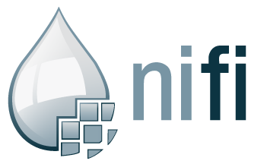
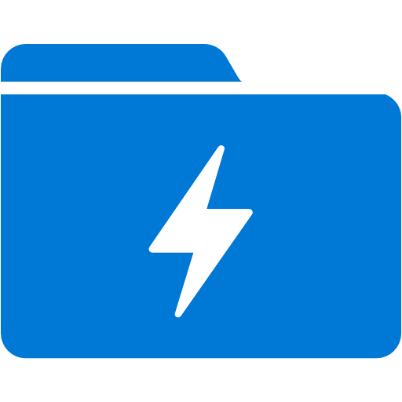


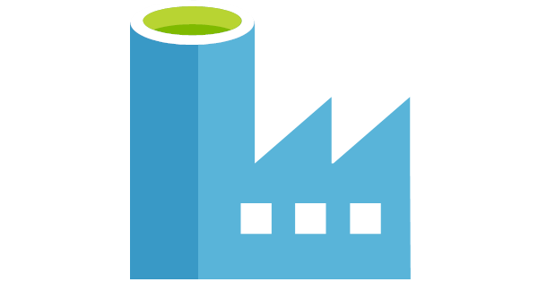

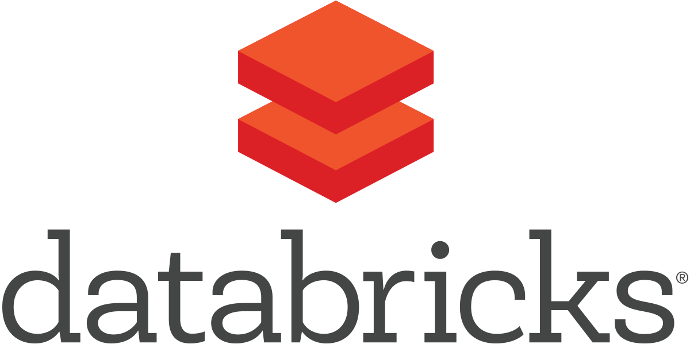
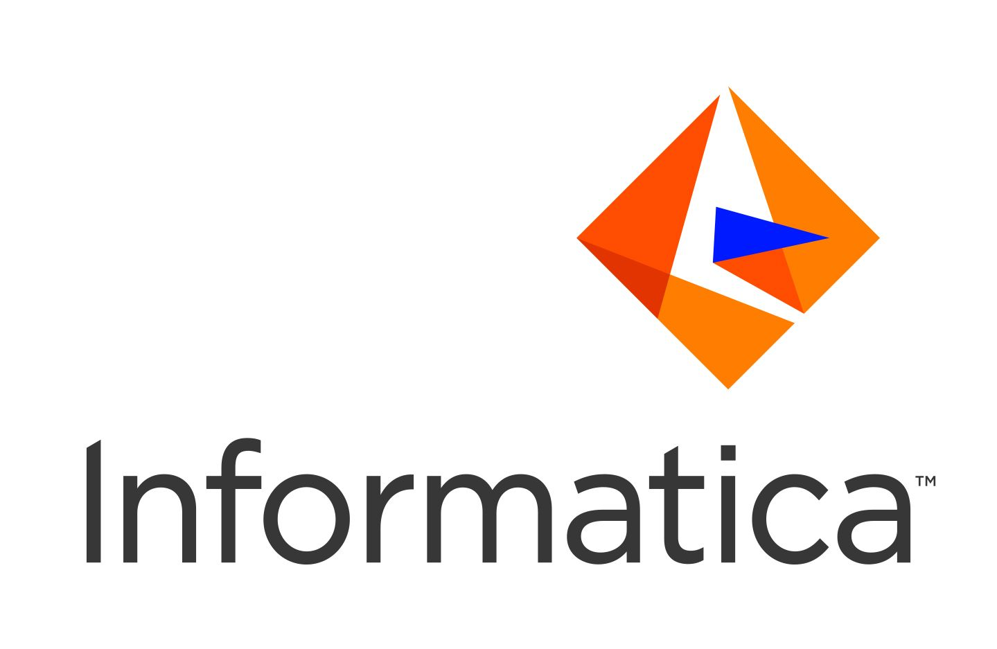
On Premise
Azure Cloud
Hdinsight Kafka
Event Hubs
Integration Runtime
ADLS
KPN Enviroment
Integration Runtime
Azure Data Factory
Data processing

Slide 4
Dependencies
Azure Enviroment
ADF integration with NiFi cluster ?
ADF Integration with Sources ?
KPN Enviroment
Can we install a Gateway in thier cluster
Will they allow connectivity directly to ADLS ( open port 443)
Will they push messages to Event Hub
Connecting Directly with Sources Instead of KPN

